Slide 1

Ethereum Price Prediction
By Nicholas Roller

Slide 2
Problem Statement
Produce a machine learning model to forecast price of ETH one year from given date
Make recommendation to trading firm based off best model as to increase, decrease or keep current position size the same with a 1-year timeline
Context: you are a new hire at a crypto trading firm, you’re first assignment is to make a time series model to forecast the price of Ethereum
Success Metrics: Model with lowest errors, forecast with 95% confidence interval
Stakeholders: Firm’s upper management and outside investors

Slide 3
Problem Formulation and Approach
From domain knowledge knew Ethereum exhibited seasonality
Would try ARIMA as our base model
FB Prophet as our more advanced model
Hyperparameter tune both models and select one with best metrics and computational efficiency

Slide 4
Data Wrangling
Data wrangling was straightforward
Forward filled the few missing data values
Created ‘Price’ variable from mean of Open and Close price
Dropped all other variables and converted date column into a datetime index for use with our time series

Slide 5
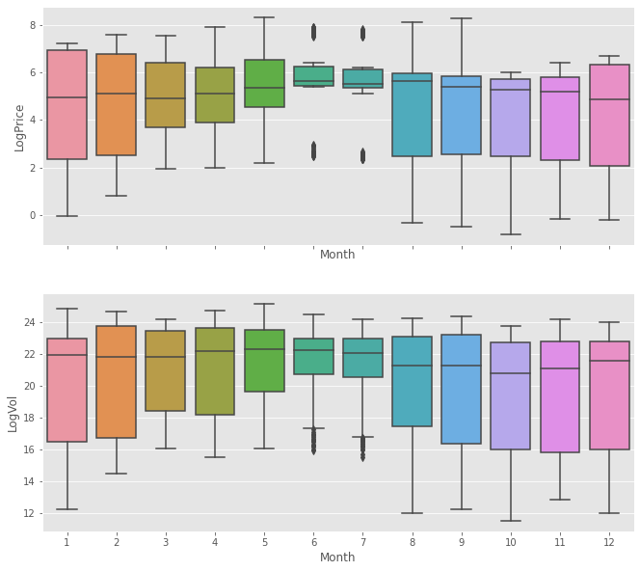
EDA
Monthly seasonality can be visualized via boxplots of Price data aggregated by month
Varied less during summer months, but with more outliers
Expect to see seasonality in our model

Slide 6
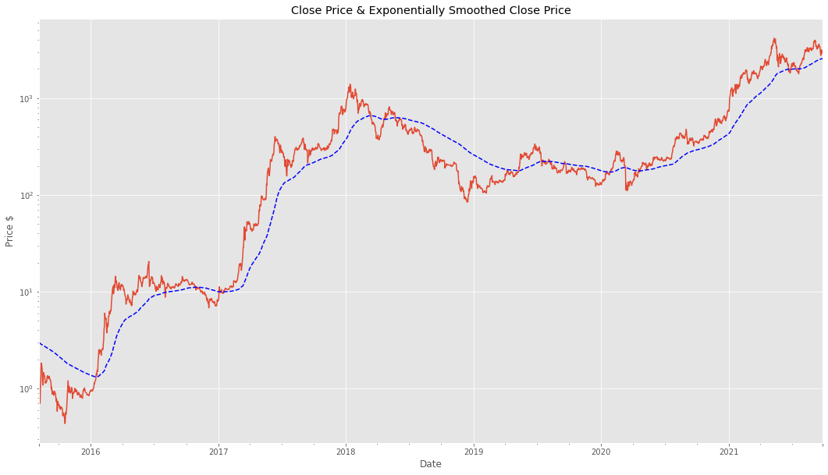
EDA – Price Trend
Plotted price trend on log plot
Plotted against its exponentially smoothed trend
Can see generally upwards trend, with seasonality on multiple time-frames

Slide 7
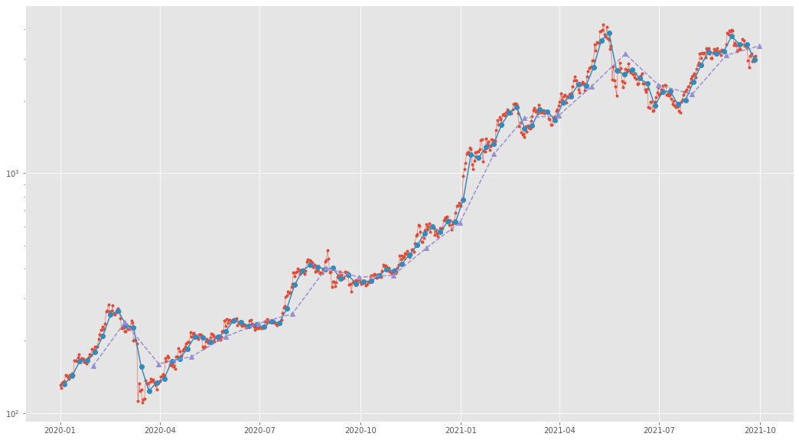
Weekly and Monthly Rolling Means
Plotted 2019-2021 time series against its weekly and monthly rolling mean
Weekly rolling mean appears to capture enough detail for our model without as much of the noise as the daily data

Slide 8
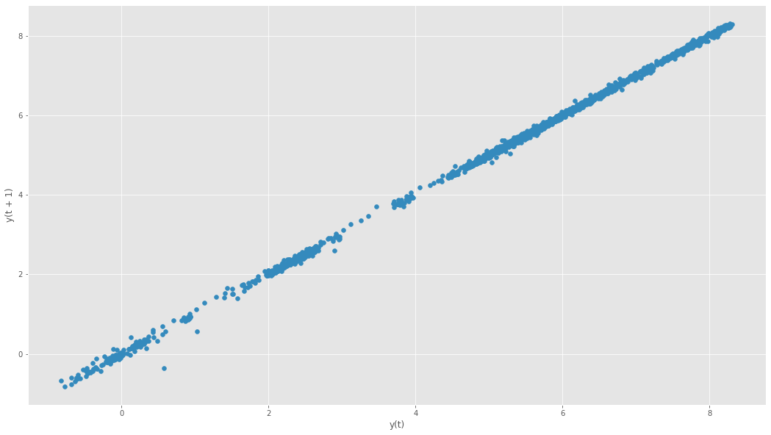
LogPrice Lag Plot
Lag_plot shows strong correlation with it’s t-1 log.

Slide 9
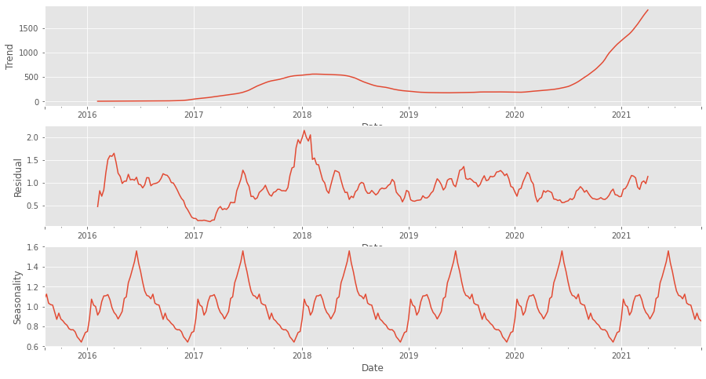
Series Decomposition
Decomposed y_log to see its trend, seasonality and residual plots

Slide 10

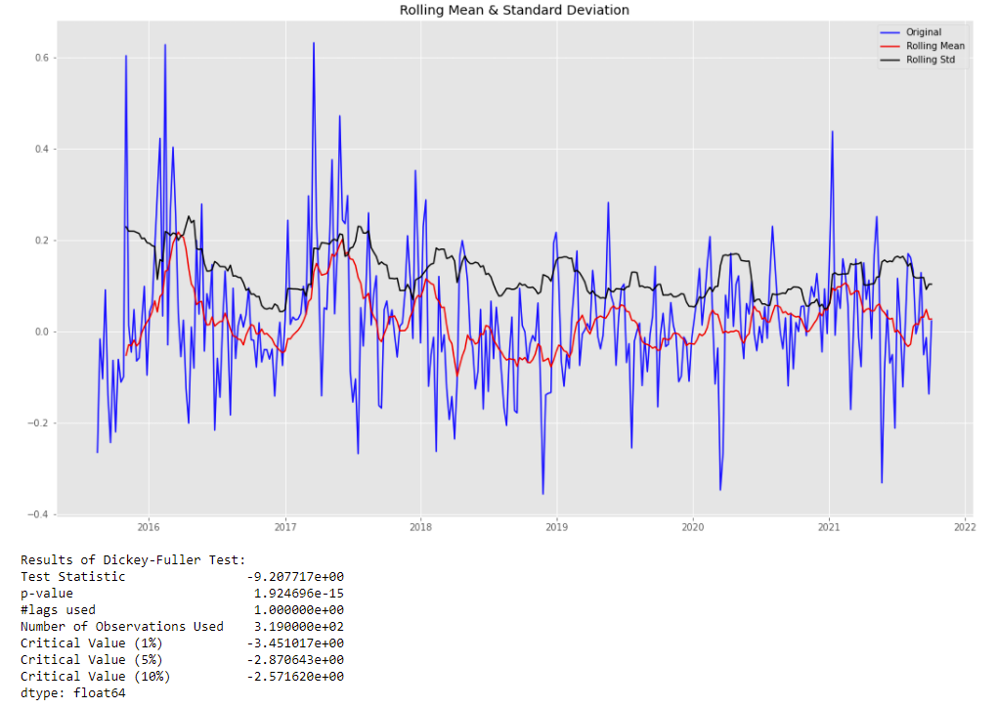
Achieving stationarity
Aggregated our model on a weekly basis for modeling
Achieved stationarity after taking the first order difference of the log time series
Dickey-Fuller Test:
P-value near zero
Test statistic < critical value

Slide 11
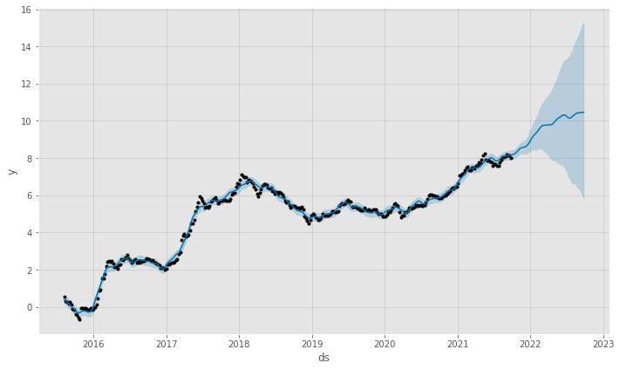
Final Model – Facebook Prophet
FB Prophet model far outperformed ARIMA on every metric
Used 11-fold cross validation to assess model and hyperparameter tune
Ran final model forecast with 52 steps with 1-week step size to forecast 1-year

Slide 12
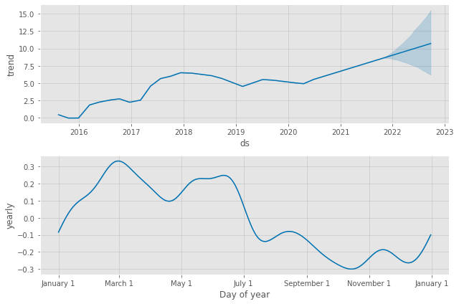
Final Model – Facebook Prophet
Plot_components showing time series trend and yearly seasonality
Model did not account for weekly or monthly seasonality, as can be seen here
General trend is upwards, and seasonality shows later-half of the year as the opportune time to invest

Slide 13
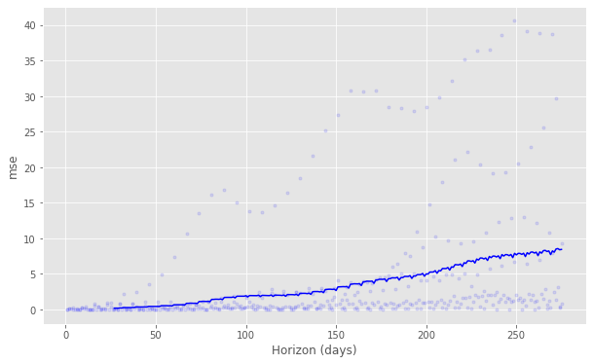
Final Model – Facebook Prophet
MSE: 0.0327
MAE: 0.1427
1-year forecast: $35,024
Upper-limit of 95% confidence interval: $423,311
Lower-limit of 95% confidence interval: $340

Slide 14
Final Recommendation
Increasing investment portfolio size in Ethereum is advised based on our model’s findings.
Forecast 1039% increase in ETH price from current date and return on investment
As high as 13,750% return on investment and potentially as low as -89%
Model could potentially be improved by further hyperparameter tuning and addition of daily, weekly and monthly seasonality, however at the cost of additional computational resources
Historically, ETH has been highly correlated to price of Bitcoin, BTC, so a more complex multivariate model could improve forecasts as well.

